Slide 1

Mapping for Strategic Impact
7th International Researchers’ Conference
Kuala Lumpur, Malaysia
Steve McCord, Ph.D.
Notes:
[Set up animation]
This presentation will make the case for using maps to focus and refine strategic efforts and identify opportunities for ministry. I will use a tools which are available to you to “see” your data and research in new ways through mapping.
For many years, the mission research community has consumed information and data in various forms such as spreadsheets, lists, and text documents. Each of these tools have advantages and are extremely useful in their proper place. However, not all of the tools we have used have given us a good perspective on the data. These formats do not provide an effective method for “seeing” strategic data in a way that combines multiple sets of information into a more comprehensive perspective of what is occurring.
This session is an applied session as we will demonstrate the “how tos” to enable you to map.

Slide 2
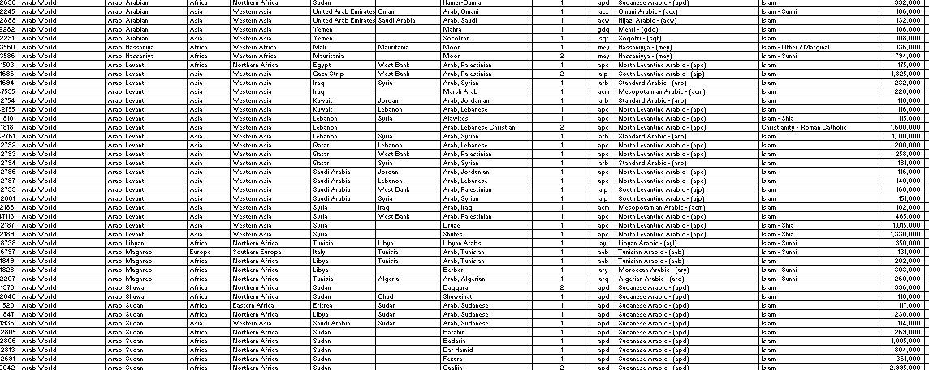
Spreadsheet data
Notes:
Spreadsheets serve as an excellent vehicle for presenting large amounts of numerical data which fits neatly into rows and columns. This slide shows a spreadsheet with 42 columns and 375 rows and it is a subset of a people group list – 367 rows of UUPGS.
Spreadsheets do a great job of isolating a single row or calculating columns but they are limited in showing the relationships spatially. You can sort by attributes such as country, city, language, or religion.
One challenge with spreadsheets is many people do not or are unable to consume this data in a spreadsheet.
Another challenge is hard copy data which is unavailable in electronic formats so extraction is not easy. Scraping websites for data is a very inefficient way to gather data. Another issue we face is awareness of other data that might inform or enhance our research. Who has already studied this topic? Has it been done with my research interest or do I want to take another slant on the problem.
I believe there is data out there ready to be consumed through maps.

Slide 3
Today’s Questions
Where is a specific people group?
How close is that people group to another similar group?
What physical barriers might hinder the gospel flow?
How have maps been used historically?
Notes:
Mapping for strategic impact presents a rationale, method and tools used to visualize data about various research components. Through the use of interactive maps, researchers can “see” information and relationships which are not clearly evident with a list view. By combining various data layers from publically available sources such as demographics, information on natural disasters, what other agencies or groups are working in country, researchers can advise strategists where to deploy their resources for maximum impact.
Today I will teach you how to use maps for strategic impact through answer the these questions. All the data I am sharing today is publically available for you through peoplegroups.org and ArcGIS Online.
Where is a specific people group?
How close is that people group to another similar group?
What physical barriers might hinder the gospel flow?

Slide 4
Today’s Questions
Are there physical or health needs which might create openness toward to gospel of Christ?
Are there multiple factors which might make create an opportunity for ministry or access?
Notes:
Are there physical or health needs which might create openness toward to gospel of Christ?
People are more open to the Gospel when they are in times of transition. The Nepal earthquake has opened doors for relief agencies that were not open prior to the quake.
Are there multiple factors which might make create an opportunity for ministry or access?

Slide 5
Strategic Impact Defined
Define strategy:
  Strategy as the central integrated concept that spells out how we will achieve our objective. Plan to achieve particular goals over time
Define impact:
  To influence, to affect, to have an impact on.
Notes:
Strategy: Webster's defines strategy as: : a careful plan or method for achieving a particular goal usually over a long period of time OR the skill of making or carrying out plans to achieve a goal
Impact: To influence, to affect, to have an impact on
As researchers, it is our desire to influence, inform, and guide strategists toward making informed decisions with the very best information possible. We seek to answer questions and discover data which will enable our organizations to be more effective, efficient, and use resources in the most impactful method. All of this ties together with strategy. It is my sincere belief that you and I want to make a difference with the work we do. This is where strategic impact comes into play.
Digital interactive maps allow users to explore their own areas of interest and use information in a way not possible with printed maps.
Let’s take a look at some historical early maps to get a sense of how far we have come. How have maps been used strategically previously? Let’s look.

Slide 6
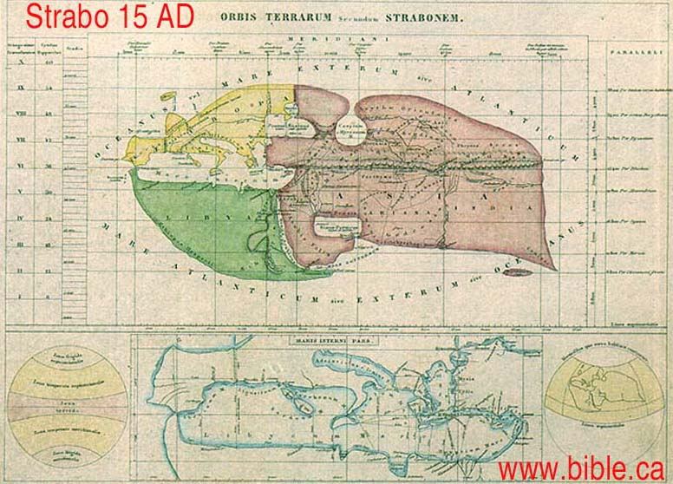
Notes:
Maps have been with us for a long time. Here is a map by Strabo dated 15 AD.
Strabo was a Greek Geographer from 64 BC-24 AD.
Viewed the Red Sea as a single finger of water. There is no evidence that Strabo know of the Gulf of Aqaba. It was the Suez and Persian Gulf. There is no evidence that Strabo understood the actual shape, size of position of the Gulf of Aqaba, Suez or the Sinai Peninsula. This geographic error continued down to 1800AD
He was the 1st geographer to mention Israel and had a working knowledge of Israel.

Slide 7
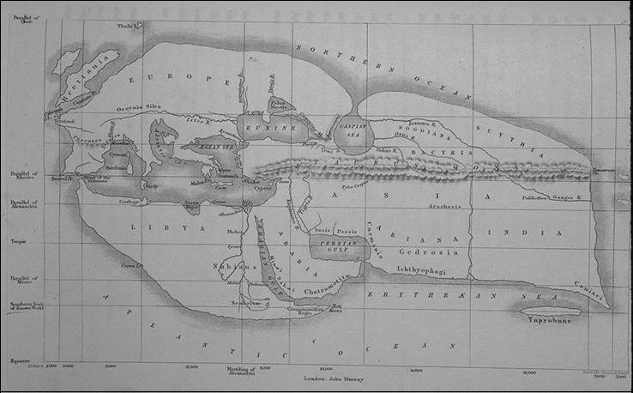
Notes:
Maps have been with us for a long time. Here is a map by Strabo dated 15 AD of his known world. Notice the differences in shapes and continents. Strabo traveled extensively, gathered notes, and visited Rome and Alexandria
What do you notice that is different from today?

Slide 8
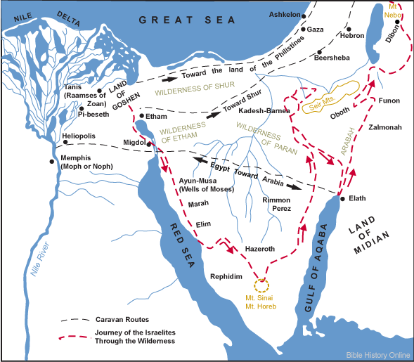
Notes:
This is a much more modern map tracing the Israelite Exodus from Egypt to the Promised land. This depiction is uses modern geography and gives much more information than Strabo’s map. In thinking about these two maps side by side, with the lack of specific detail in the Strabo’s map, it is easy to understand why the Israelites wandered. They did not have an accurate representation of their landscape.
The Red line traces the Exodus route with trade routes shown in gray. This is an important distinction in that it is possible to show multi-sets of data using different symbology.

Slide 9
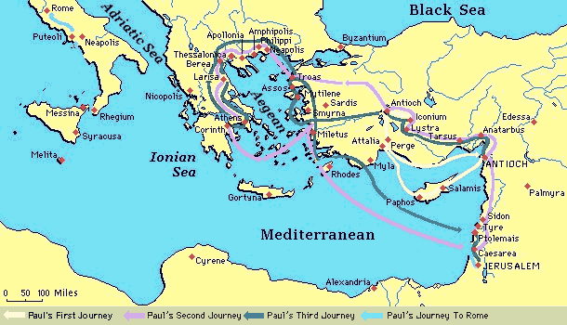
Notes:
We grasp Paul’s missionary journeys very quickly when we see a map. Maps give us a larger context in a geographical space. Since this map focused on areas around the Mediterranean, mapping is more accurate than over open spans of empty space.
Let’s shift gears from the map to what the information on the map says about those making maps.

Slide 10
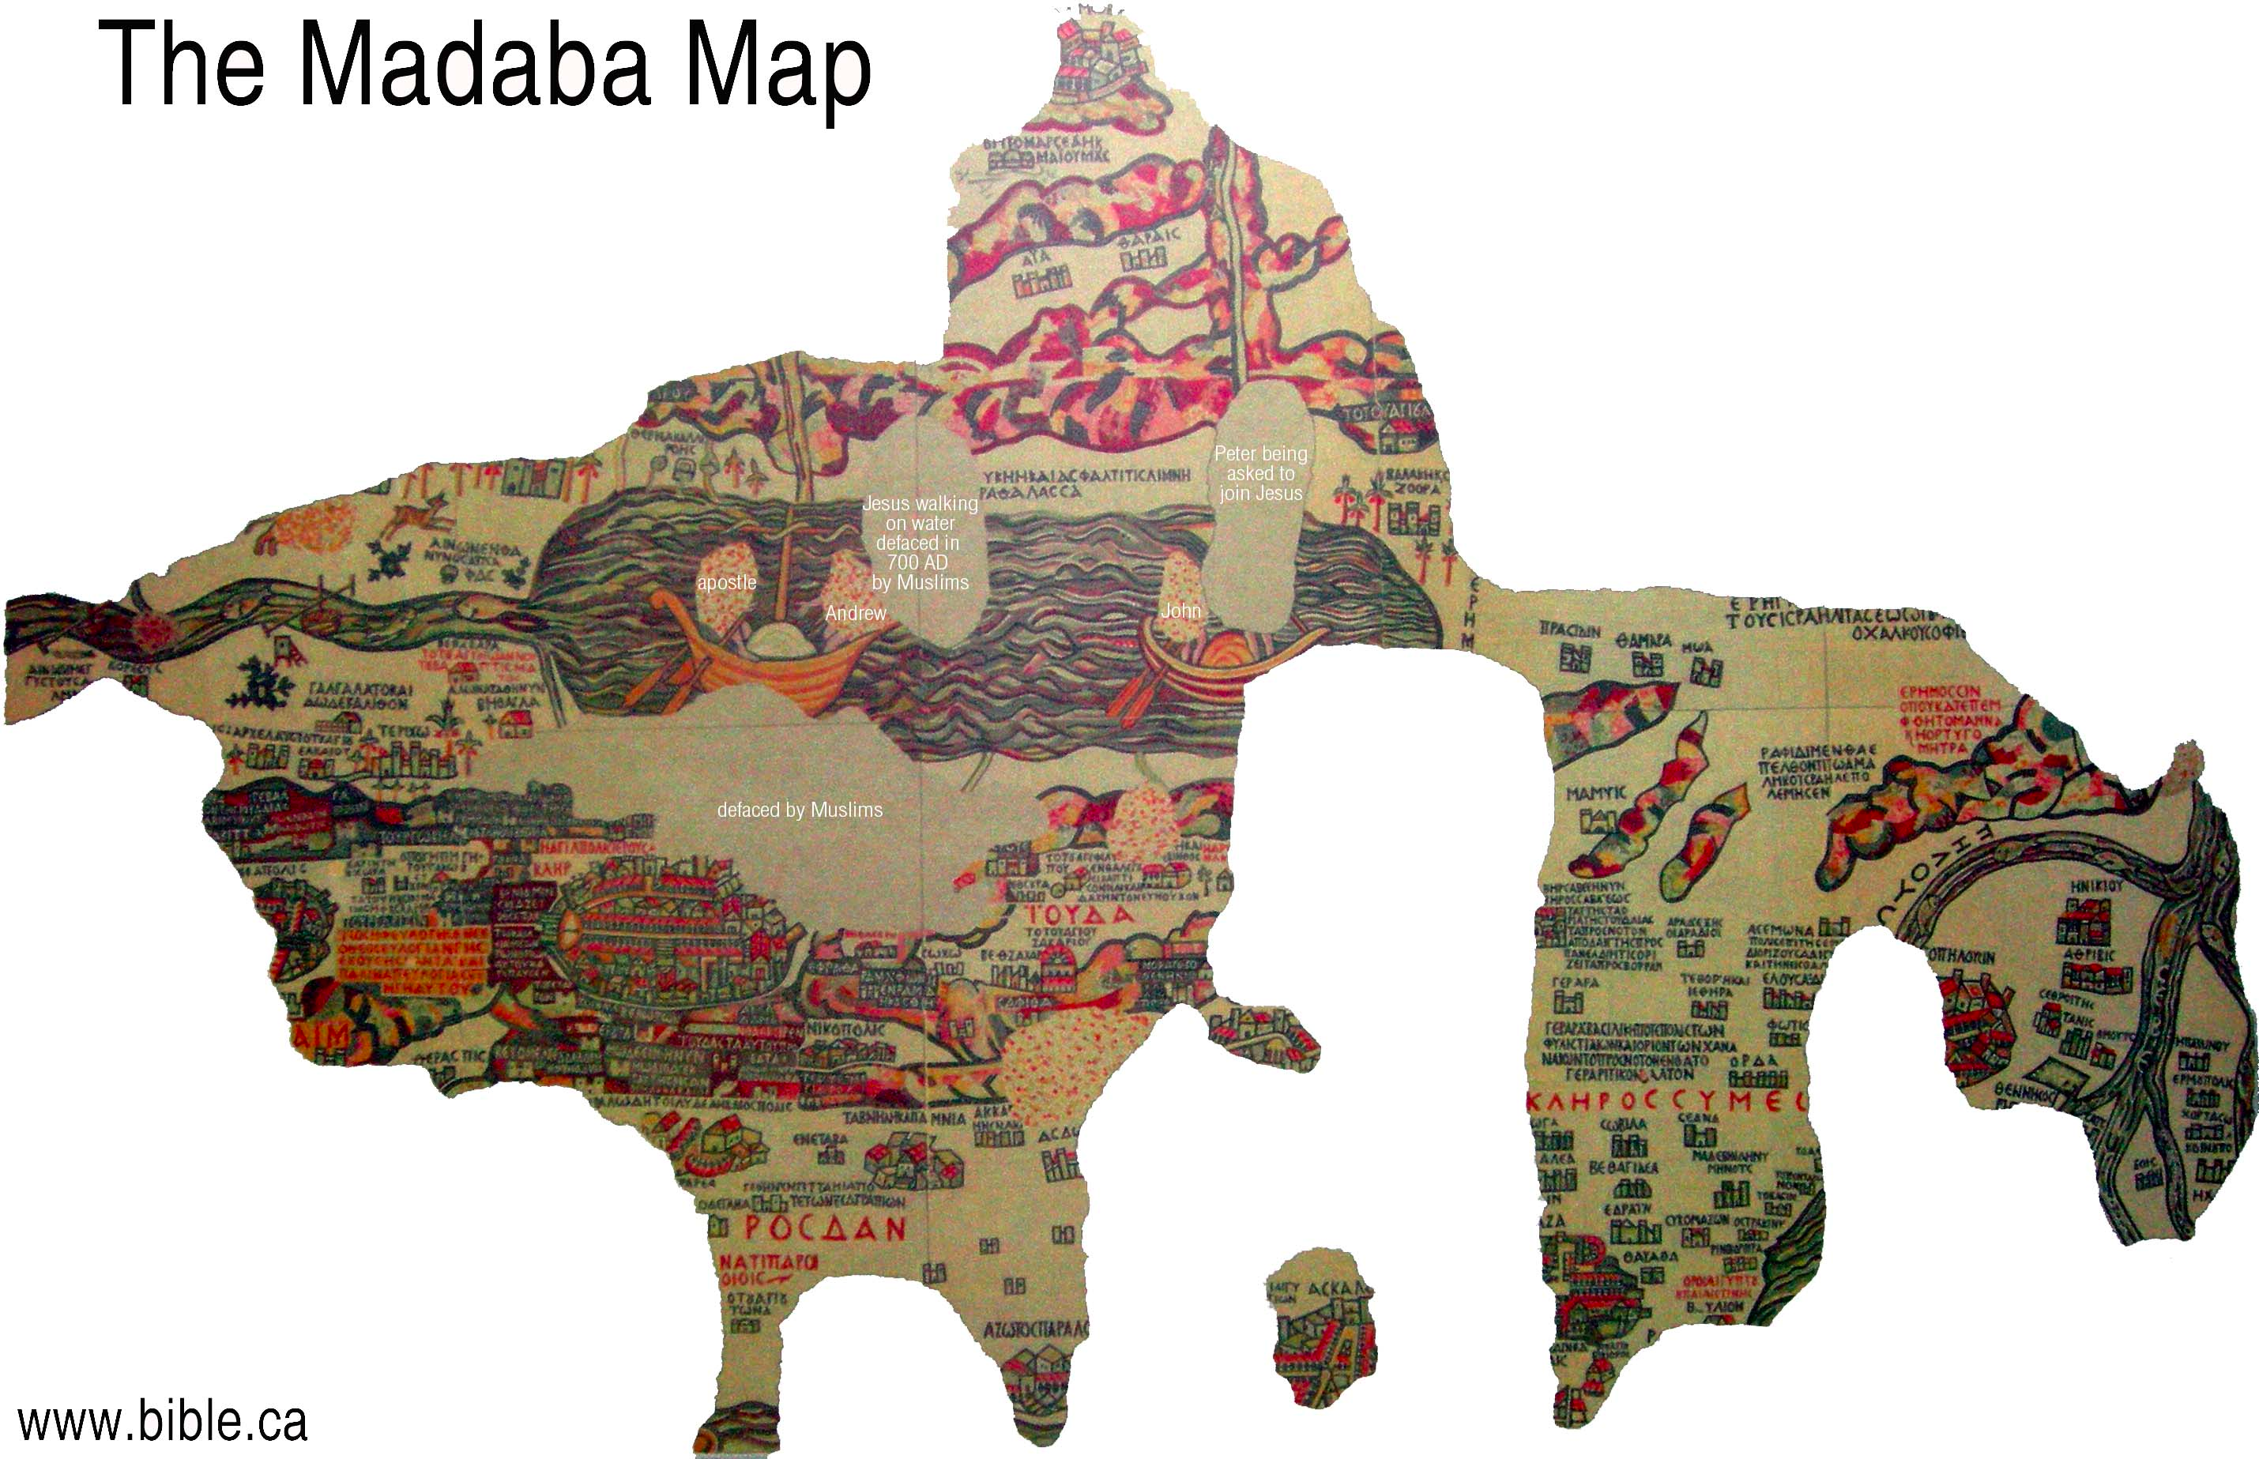
Notes:
This is the Madaba Map which is a mosaic map found in the floor of St. George Church in Jordan. It represents the middle east in 542AD. It was buried in 746 as an earthquake destroyed the existing church. This map was rediscovered in 1884 during construction of a new church.
This map is oriented east with two fishing boats in the Dead Sea. Jerusalem in the lower middle. Maps orient us to our world.

Slide 11
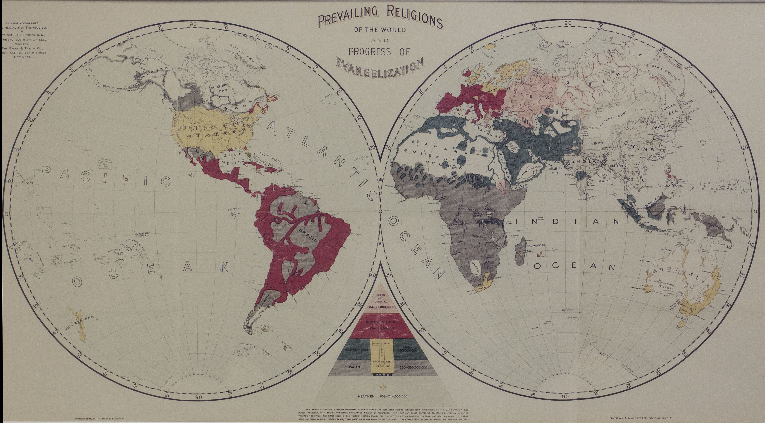
Notes:
Maps have been a part of mission strategy as guiding forces to reach the unreached and go where the Gospel has not gone. This is a map indicating prevailing religions and the progress of Evangelization from 1894.
Although it is difficult to see, this map gives a visual representation here of how mission researchers viewed the world in their day. The definitions and nomenclature were very different than those we use today.

Slide 12
Notes:
Let’s look at this in more detail. This was a guide for missions as they decided to move toward the unreached. Geography had improved during the European colonization period and maps were more accurate depictions of more than just geography. Corrections to Strabo’s map were incorporated so we can see the Red Sea and the Persian Gulf.
Notice the Sahara and Gobi deserts. The empty quarter of Saudi Arabia. GOLD stars represented mission stations. The stars are very difficult to see as the map has faded but they are found around the edges of Africa.

Slide 13
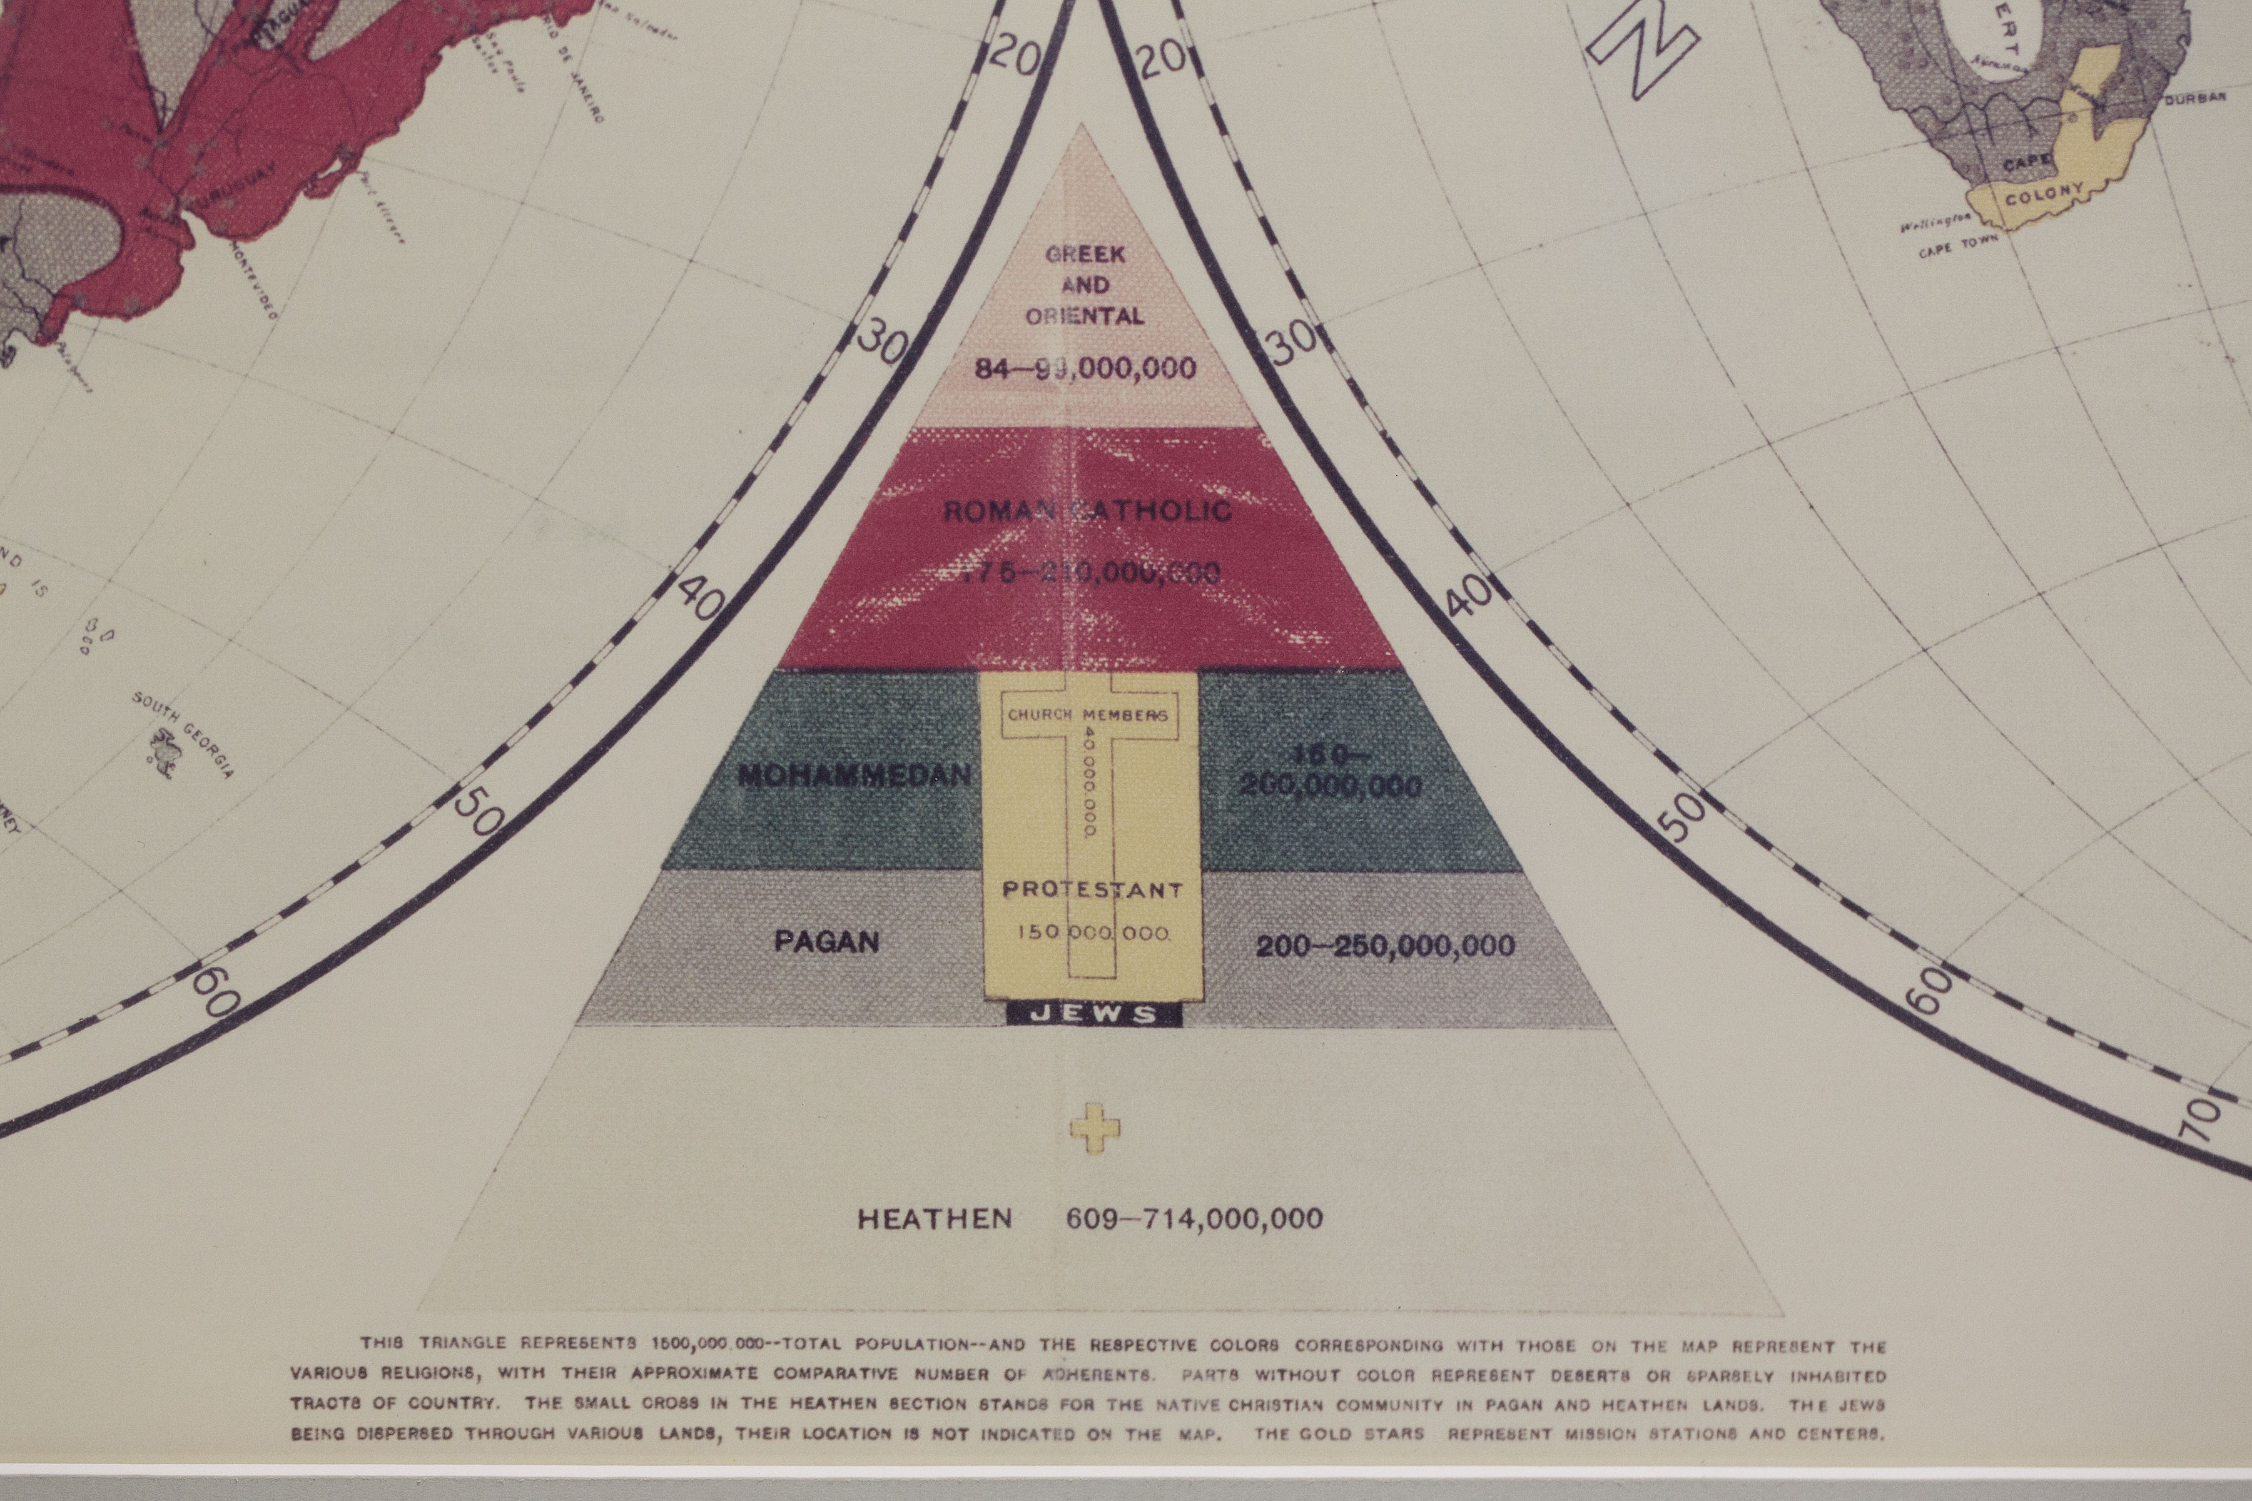
Notes:
Regarding strategy, this was the legend to the map. The religious categories were Heathen, Pagan, Mohammedan, Jews, Protestant, Roman Catholic and Greek & Oriental. GOLD stars represented mission stations.
This map represents the best in missiological thinking and their understanding of research data. Much of the information shown here was gathered from various mission agencies and missionaries themselves. This map raises several questions.
How do we define other religions?
How do demographics impact strategy?
What other questions does this map raise for you?

Slide 14
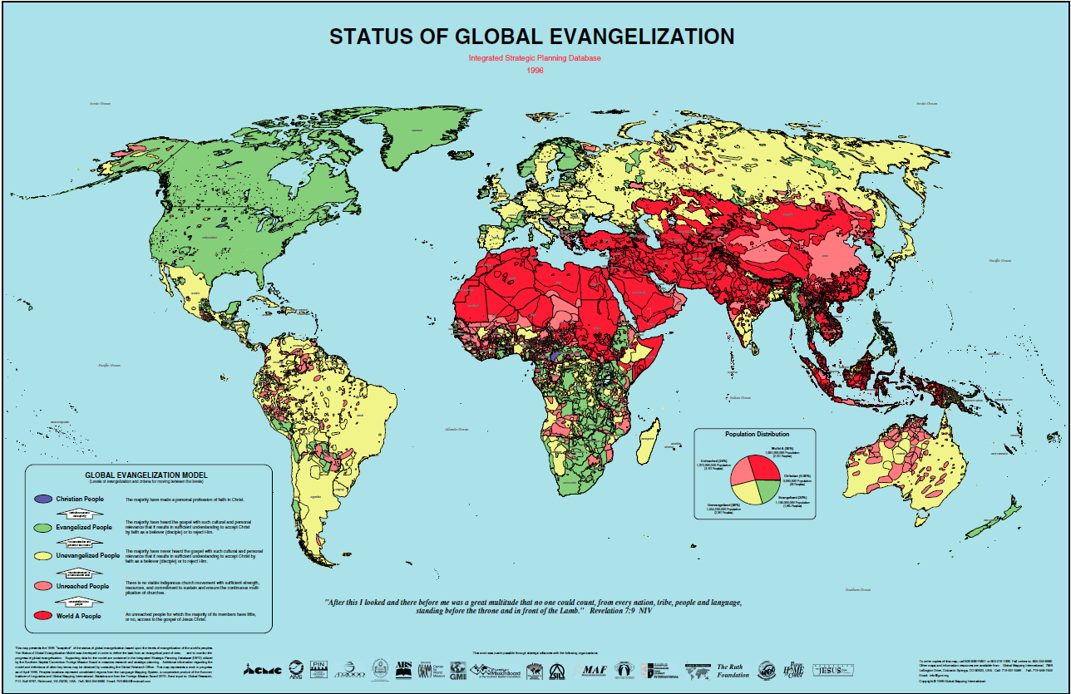
Notes:
Over the next 100 years, many changes occurred in what became available for showing progress of the gospel. With computer mapping programs such as Atlas Mapping Software and the event of databases, it became possible to map the spread of Evangelization globally. In 1996, Global Research working with our many partners produced the Status of Global Evangelization Map (SGE Map) using data from various agencies to build a language map of all peoples. For many, this was the first time they saw lostness visually. Based on this map and the data, It was possible for us to see the spatial relationship between people groups, identify people group language boundaries AND identify incorrect data.
The data behind this map was developed by GMI and SIL based on language. Each of the polygons represents a separate language with the Global Evangelization Model scale on the polygon. At this point in history, missiologists referred to people in World A, B, or C. World A peoples are ethnolinguistic peoples of which half their members have little, or no, access to the Gospel. This map focused on access to the gospel. Again definitions come into play here. What do we mean by access? Is having a Bible in one’s language access to the Scriptures or is the second issue of availability more critical for evangelization? The 1040 Window was part of this understanding of people groups

Slide 15
Notes:
Over the next 100 years, many changes occurred in what became available for showing progress of the gospel. With computer mapping programs such as Atlas Mapping Software and the event of databases, it became possible to map the spread of Evangelization globally. In 1996, Global Research working with our many partners produced the Status of Global Evangelization Map (SGE Map) using data from various agencies to build a language map of all peoples. For many, this was the first time they saw lostness visually. Based on this map and the data, It was possible for us to see the spatial relationship between people groups, identify people group language boundaries AND identify incorrect data.
The data behind this map was developed by GMI and SIL based on language. Each of the polygons represents a separate language with the Global Evangelization Model scale on the polygon. At this point in history, missiologists referred to people in World A, B, or C. World A peoples are ethnolinguistic peoples of which half their members have little, or no, access to the Gospel. This map focused on access to the gospel. Again definitions come into play here. What do we mean by access? Is having a Bible in one’s language access to the Scriptures or is the second issue of availability more critical for evangelization? The 1040 Window was part of this understanding of people groups. The 1040 Window was approximately 10 degrees north and 40 degrees north latitude. And was known as the Resistant Belt with the majority of the world’s Buddhists, Muslims, & Hindus.

Slide 17
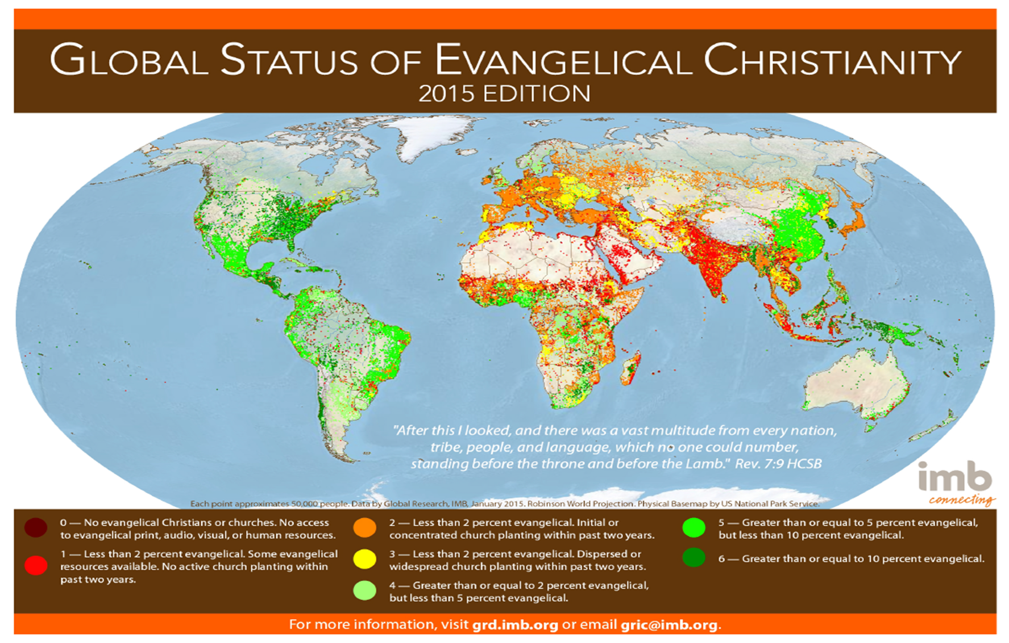
Notes:
Over the next 20 years, again many changes happened with both the Advance of the Gospel and the increasing level of precision in locating people groups and mapping them. From 1996 with the Status of Global Evangelization (SGE) to Global Status of Evangelical Christianity (GSEC) maps moved from a language polygon based approach to a point centric people group methodology with each point normalized on 50,000 people. Therefore, where there more people live, there are more dots.
This map has driven strategy through the GSEC scale. It has help in identifying the unreached and unengaged.
Downloadable from peoplegroups.org

Slide 18
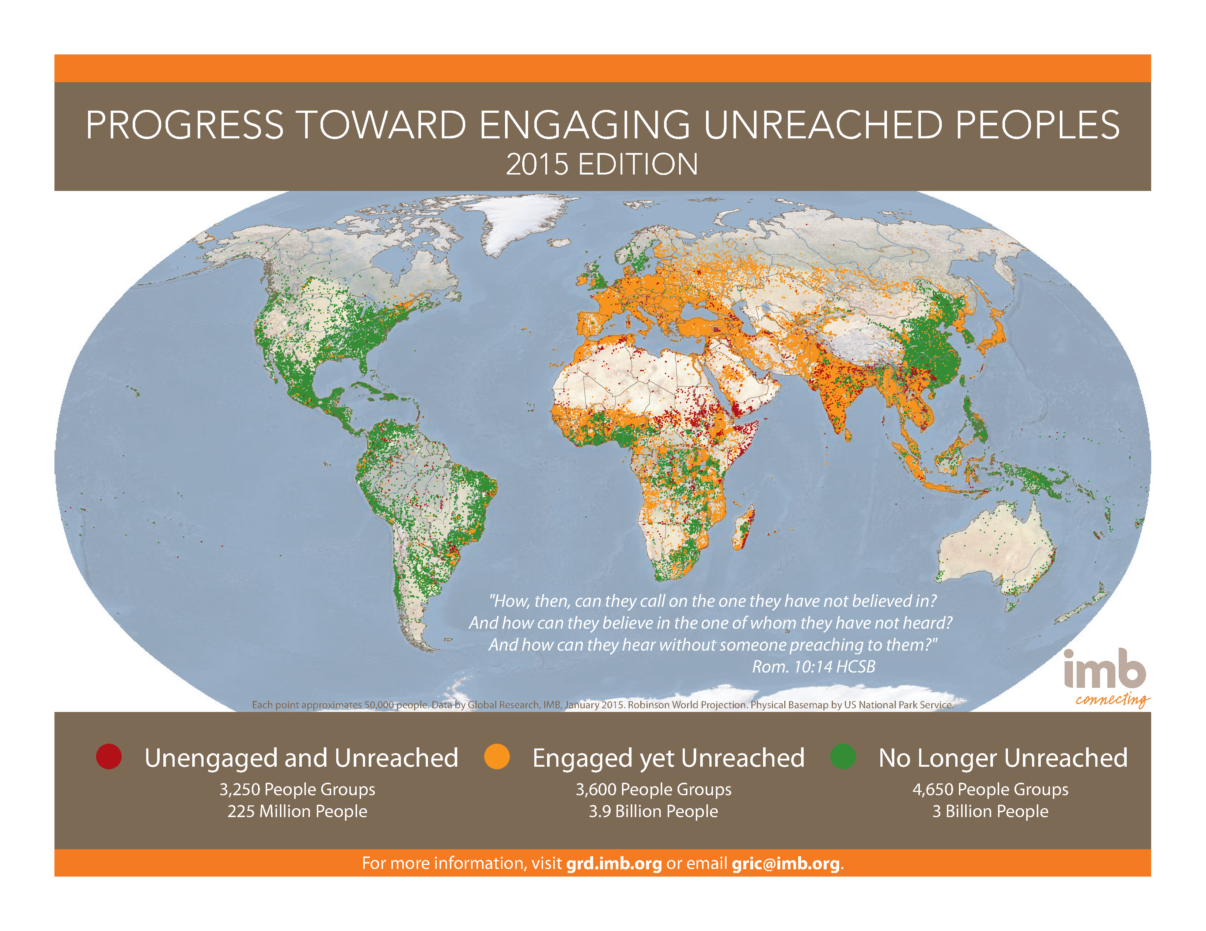
Notes:
In 2015, a new map was launched to highlight the progress made toward reaching the unreached. The symbology was simplified to three level. Easy to understand and follow for almost anyone. Again, this is available in poster and 8.5X11 page size.

Slide 19
Old maps are great, but…
Out of date the moment they are printed
Reflect a specific point in time
Expensive to print and not easily changed
Data changes rapidly
So, how do we provide current, up to date information to strategists and decision makers?
Notes:
As you can tell, I like maps. I like maps in books, folded maps, rolled maps. Why? Maps give a larger context to the strategic issues we face. There may be reasons why we cannot reach a specific people group related to physical or geographical boundaries. Maps, used strategically, can provide essential information but digital, electronic maps are even more useful.

Slide 20
Mapping your data
Digital maps are data driven
Public data is all around us
Using other people’s data is a great idea.
You don’t have to maintain or replicate it yourself
Enhance your data with other people’s information
Let’s move to an online environment so you can learn how to leverage your current data for strategic impact
Notes:
We have discussed strategy and the importance of maps.
We have looked at historical and current maps.
All maps are data driven but digital maps live off of data.
With the explosion of mapping, countries, cities, all sorts of educational and public institutions are providing data to their customers. Therefore, it is available to anyone who knows how to get it.
There are great advantages is knowing where data resides, how you can use it, and you don’t have to duplicate or replicate the data in your own databases.
Let’s dive into this and show you how readily available digital mapping is for strategic impact.

Slide 21
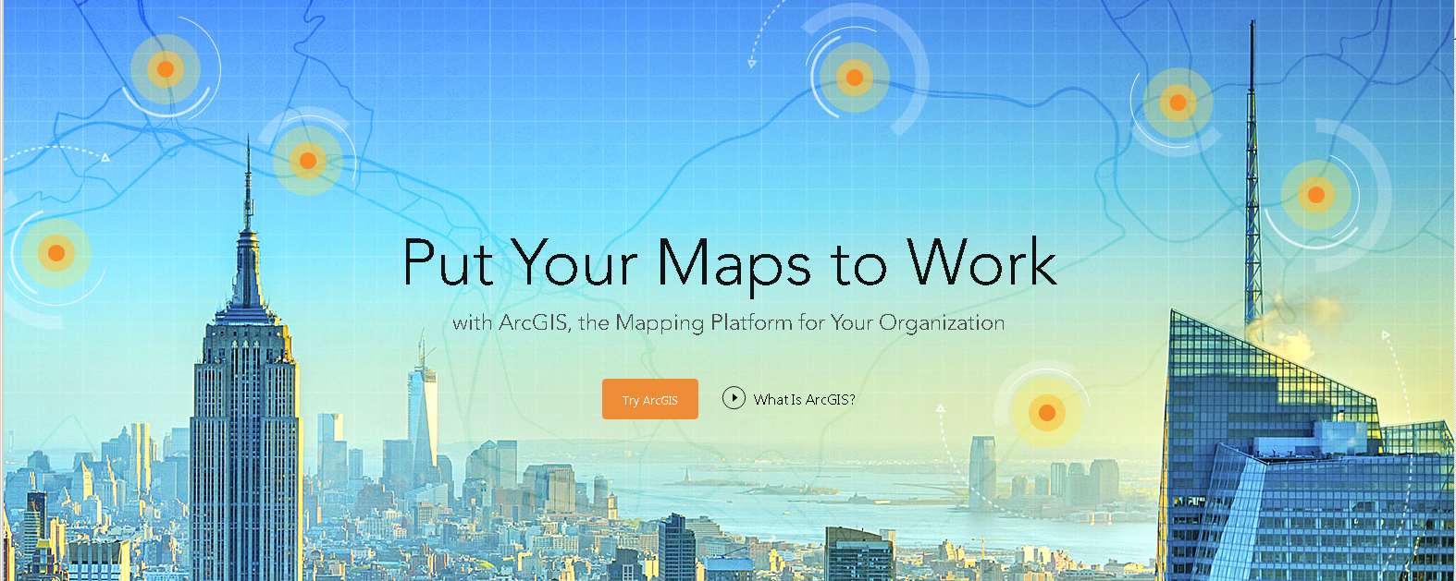
ArcGISONLINE.COM
Notes:
Until recently, making digital maps from various data sets was a time consuming, expertise laden, and tedious. In the last 2 years, ESRI (Environmental Systems Research Institute) has developed tools that do not require deep specialized training or extensive mapping experience.
Go to Arcgisonline.com
Click Try Arcgis

Slide 22
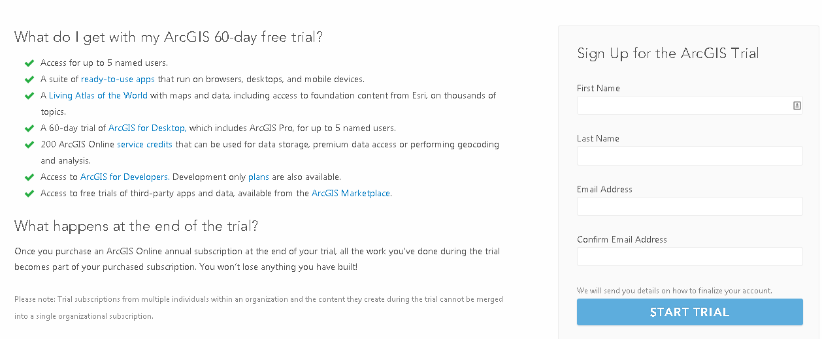
ArcGISONLINE.COM
Notes:
See what you get with this 60 day trial
Walk through the options
Look at the various options you have available to you. If you

Slide 23
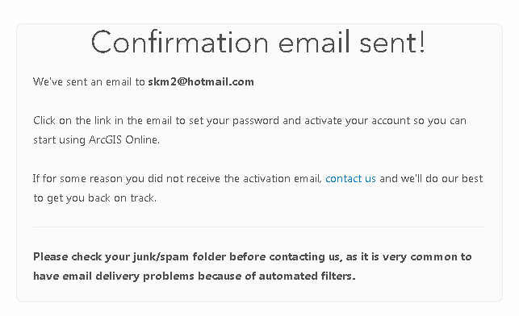
ArcGISOnline.com
Notes:
A confirmation email is received

Slide 24
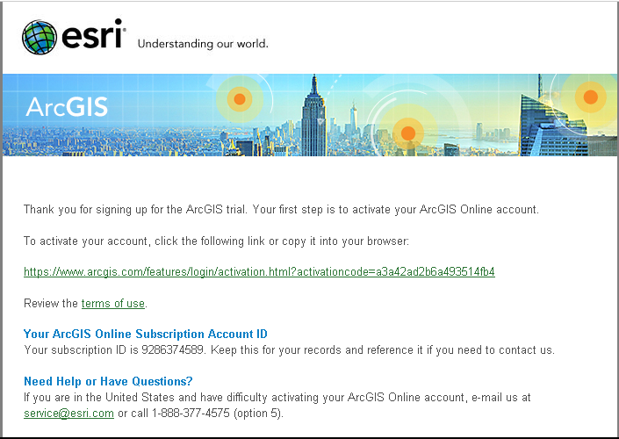
ArcGISOnline.com
Notes:
Email verification so click on the link.

Slide 25
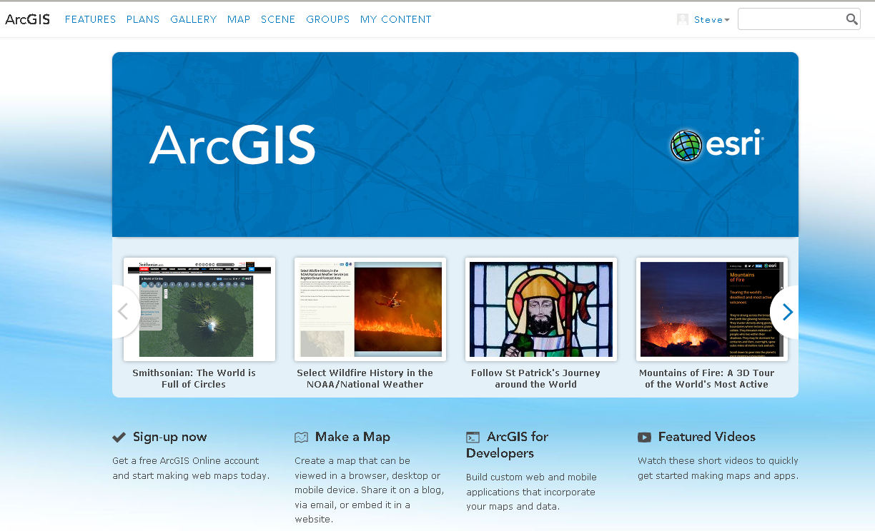
ArcGISOnline.com
Notes:
Now you are logged on to Arcgisonline – I will call it AGOL for short.
Click on map to create a new map

Slide 26
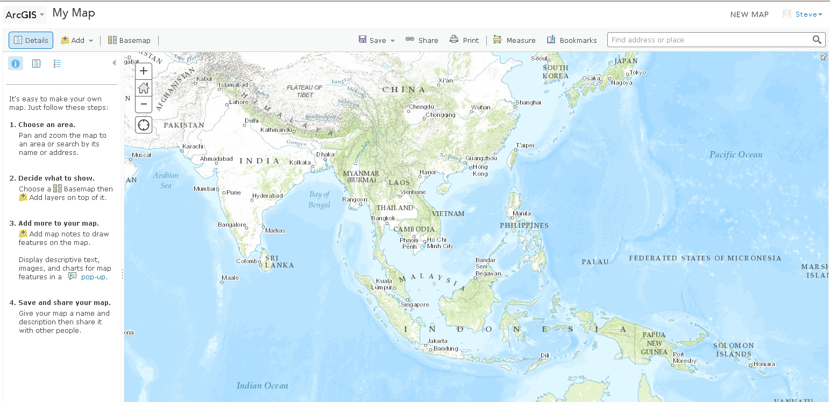
Making Maps
Notes:
Let’s talk through this screen as understanding it is key to creating good maps.
Select “Choose an area” and move the map to the area you want to view.
Select “Decide what to show” and choose a base map. – Select imagery with labels, change to Light Gray for a more subdued look.
Notice the other option in #2 – Add Layers
Here is where you begin to add data to the map.
Beginning with the ribbon bar – find the Save button. – 2 options – Save and Save as.

Slide 27
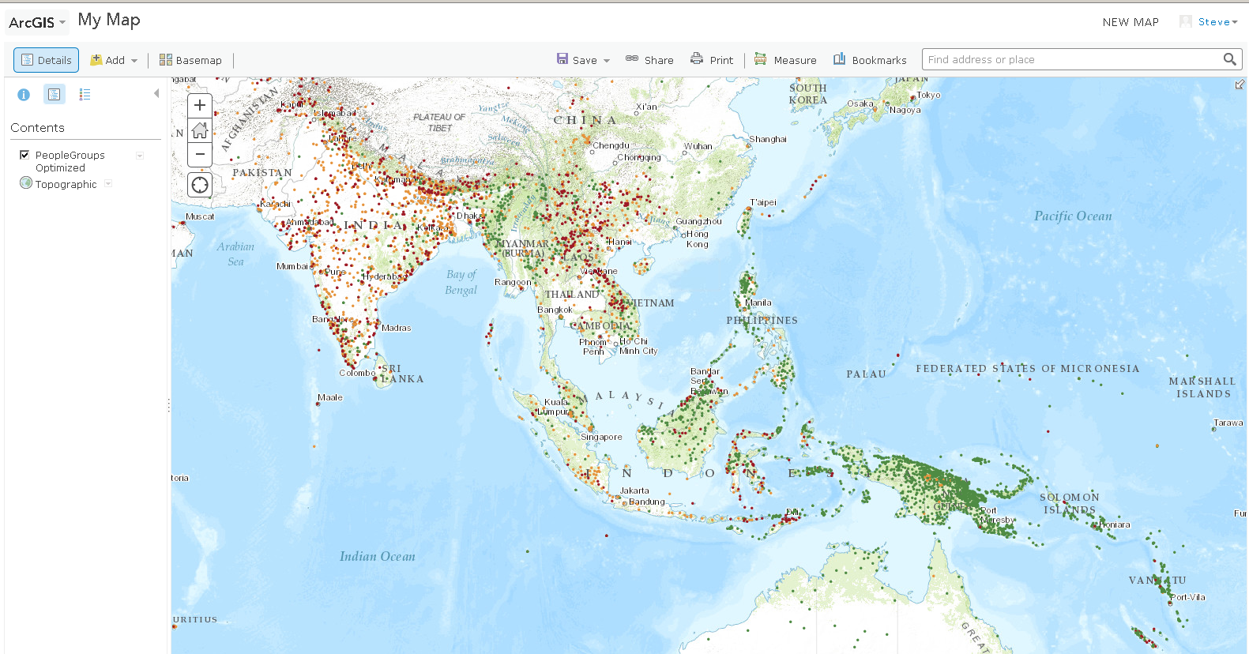
Add data layers
Notes:
Data is the engine that drives mapping. Finding the data you need is part of sharing your research.
Click on the folder button Add
Select search for layers
Enter “peoplegroups”
Select “peoplegroups_optimized” and add it
Click Done Adding Layers
What you are seeing is people group points so click on a point.
What happens? – Popups with photos
This answers one of our questions – Where are people groups? You have the ability to find people groups globally.

Slide 28
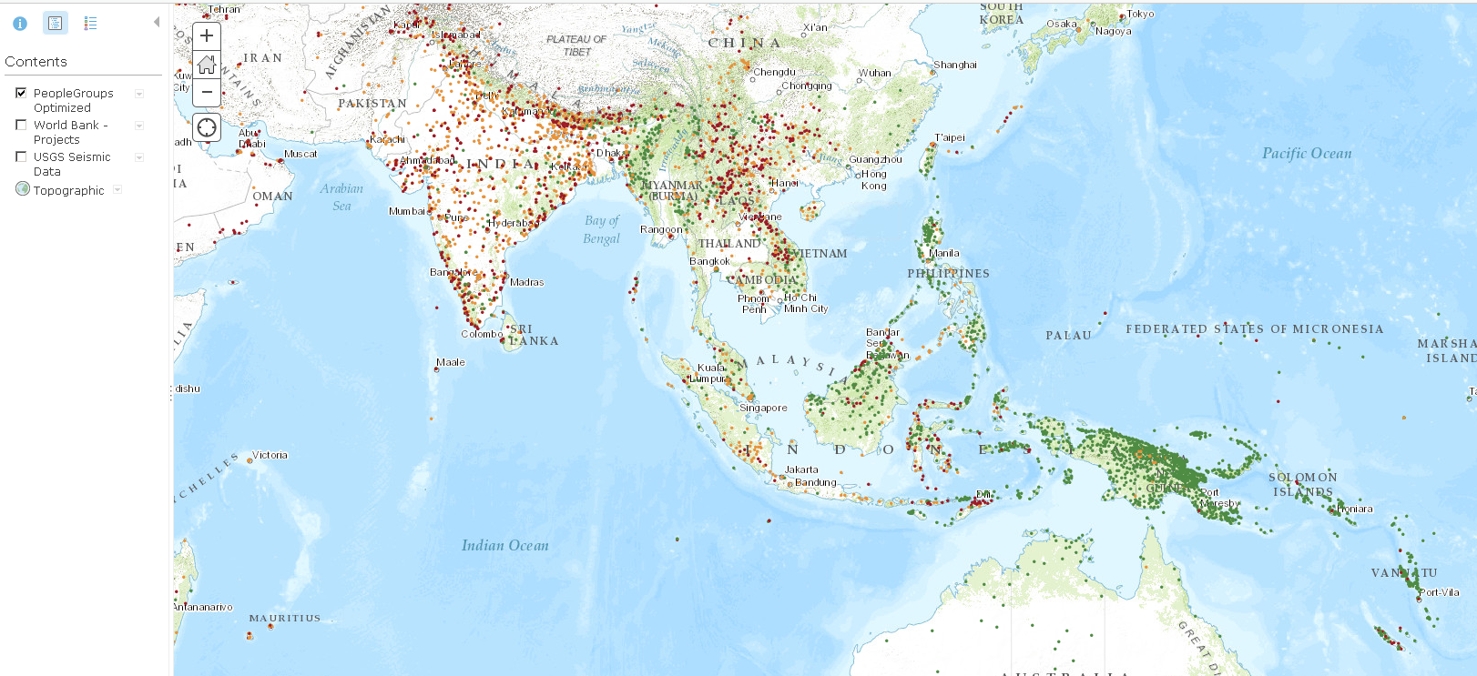
Adding People Groups

Slide 29
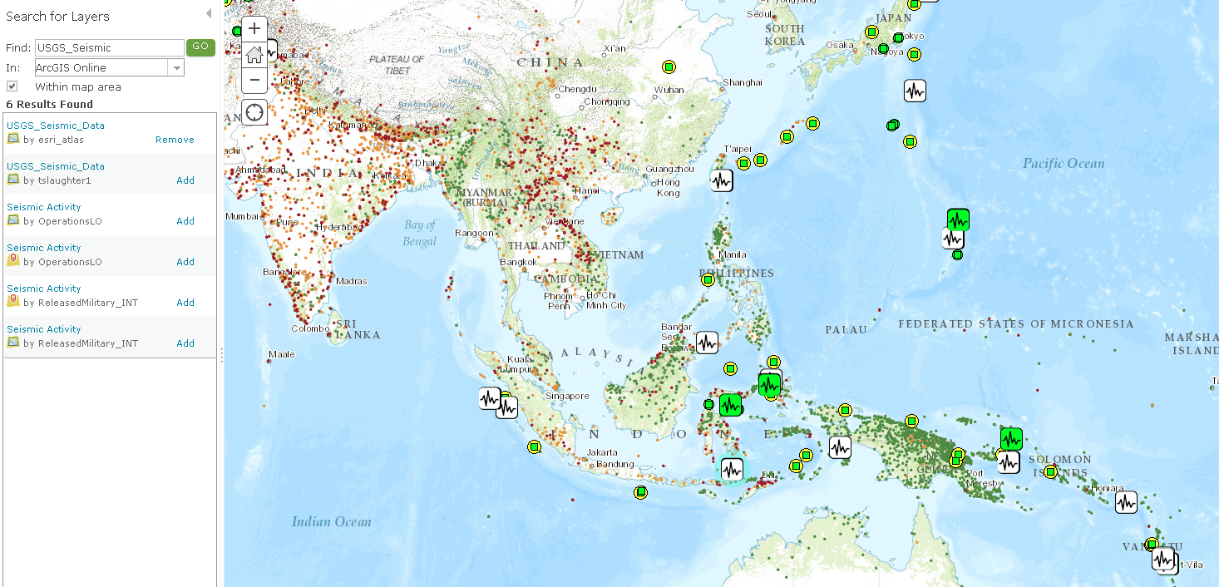
Add Earthquake data
Notes:
Now let’s look at how earthquakes impact people groups.
Search for USGS_Seismic and select USGS_Seismic_Data and add the data
USGS is a solid reliable source that is updated constantly so it provides an excellent reference point for strategic planning.
In looking for data, shop around to see what is available and who has posted the data.
Now we can look at people groups impacted by earthquakes. Strategically, this information is critically important as relief efforts begin when the shaking stops. This data is refreshed on a hourly basis so monitoring of disaster situations can be known.

Slide 30
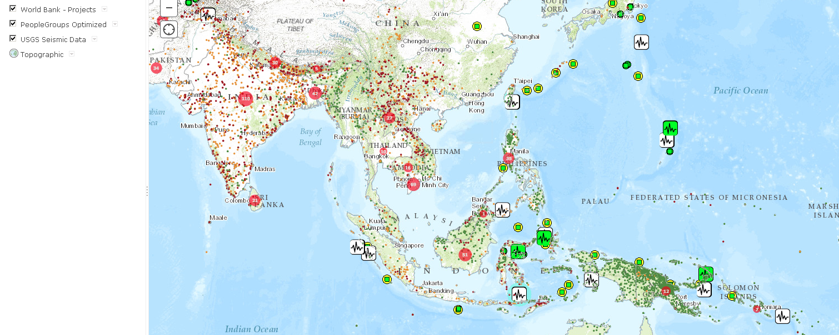
Add World Bank Project data
Notes:
Who else is working in this area? What other resources can be leveraged strategically to impact people who have suffered through an earthquake?
I pulled in World Bank data to see what they are doing and how we might partner with them for greater effectiveness and legitimacy. Mapping these resources identifies what is available for deployment.

Slide 31
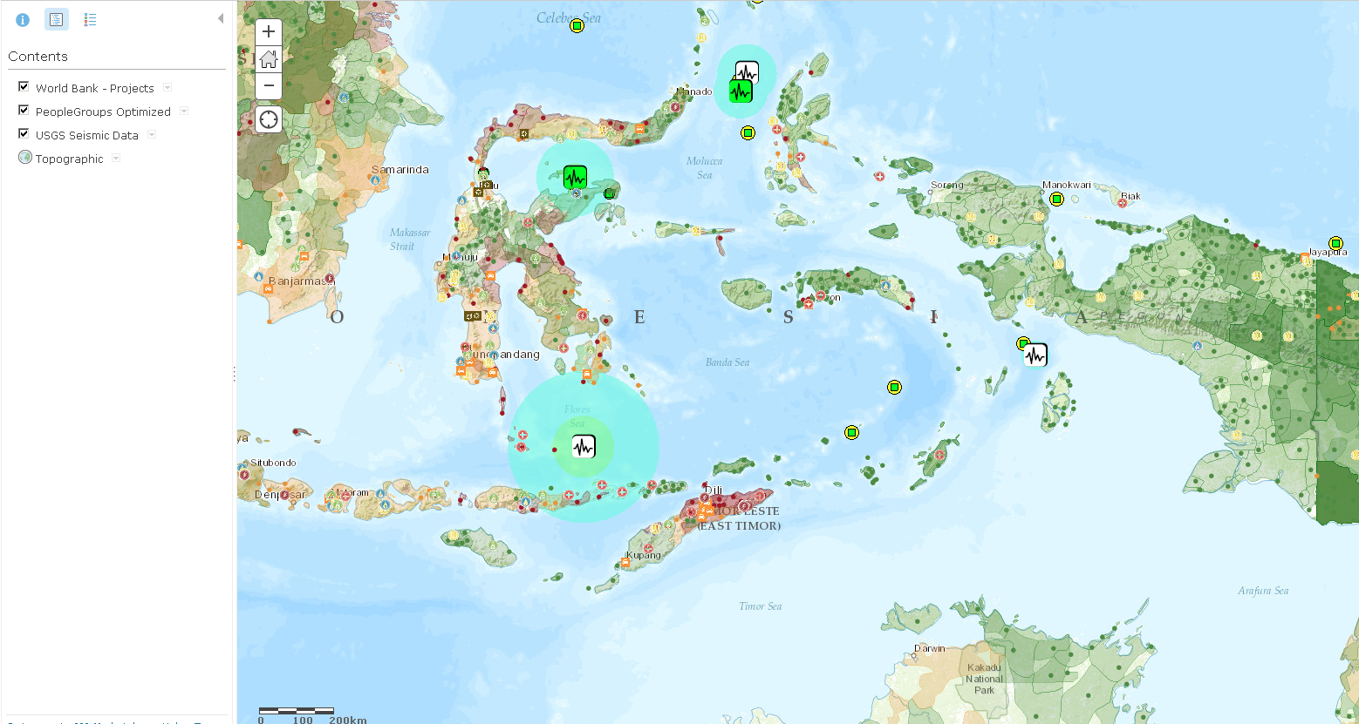
Strategic Impact
Notes:
We drill down and see people group polygons and can know the extent of a people group’s presence.

Slide 32
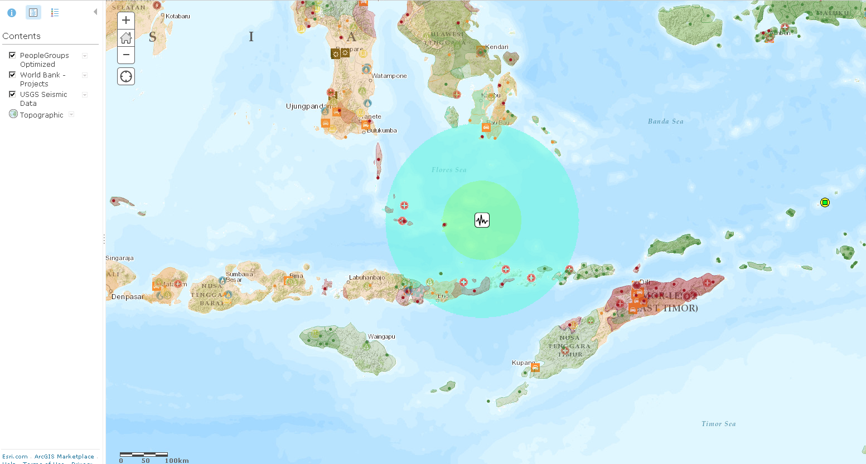
Strategic Impact
Notes:
Zoom in for greater detail information.

Slide 33
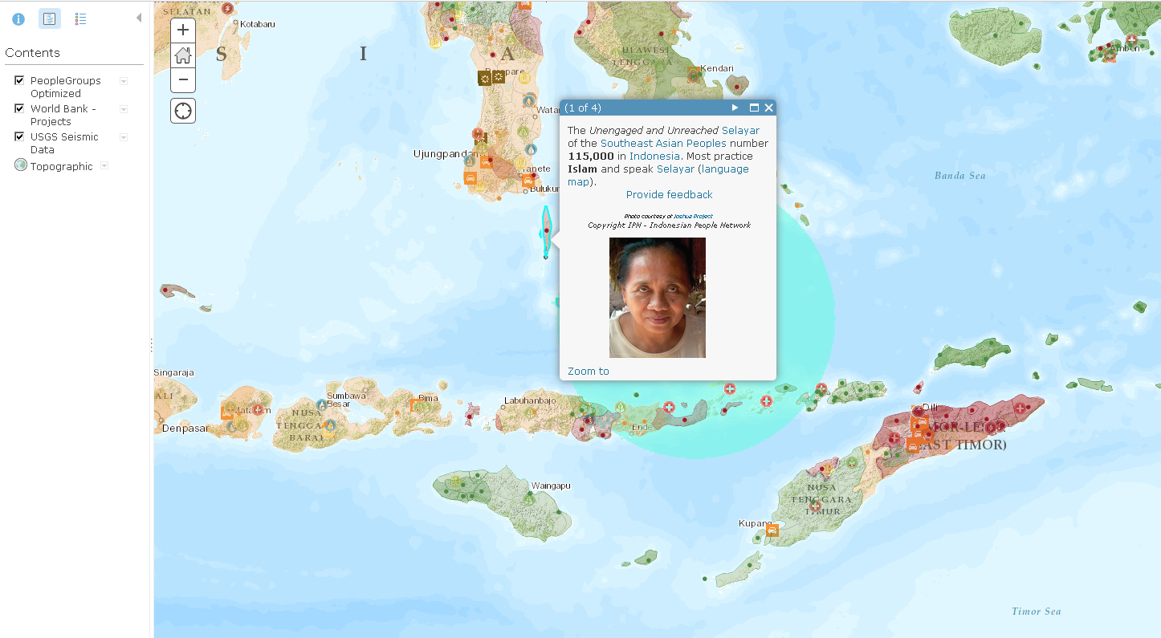
Strategic Impact
Notes:
Popups give us additional information about the data layer. People group information, earthquake and World Bank information adds a greater level of knowledge about the situation.

Slide 34
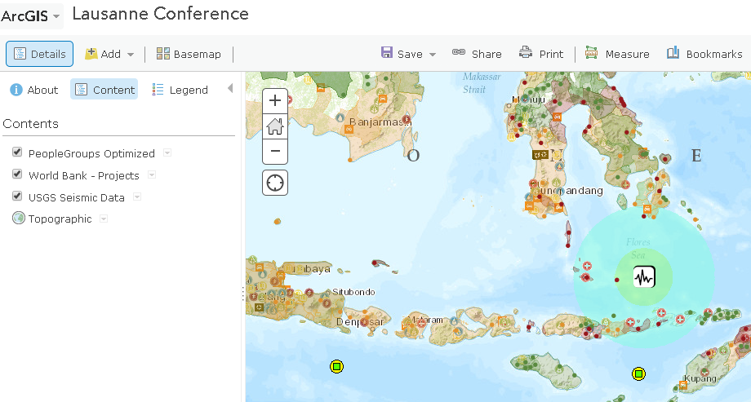
Saving and Publishing Maps
Notes:
To save your map, click on Save and choose Save As. Give it a descriptive name. AGOL saves the layer definitions and symbology for the next time you open it.

Slide 35
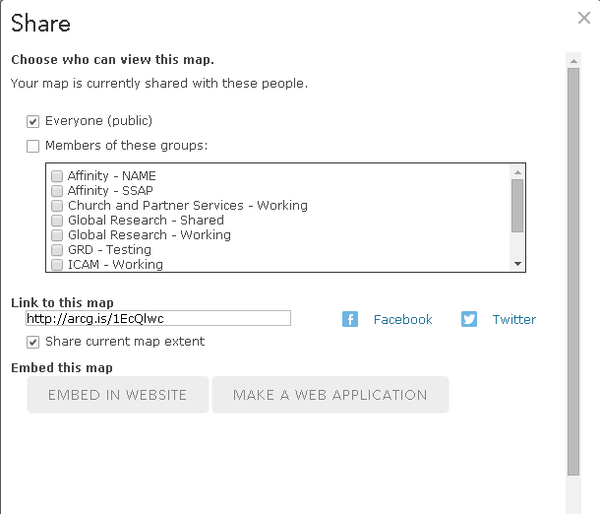
Saving and Publishing Maps
Notes:
Publishing the map to the public is required for others to see it. You can either send the Bit.ly link to other for access or embed the map in a website.

Slide 36
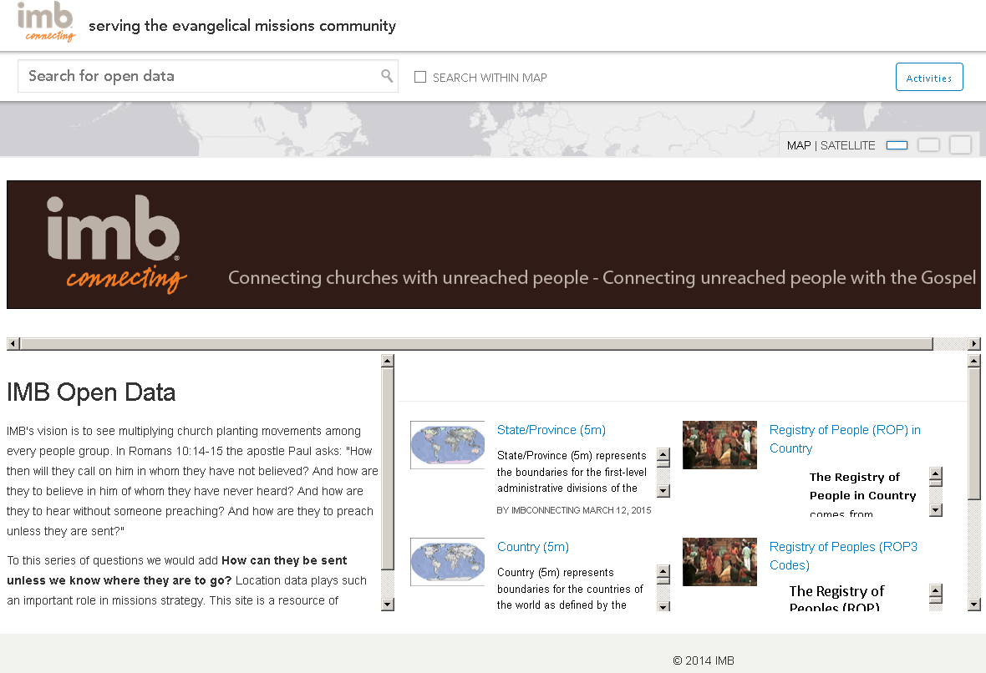
Imb open data
http://go.imb.opendata.arcgis.com/
Notes:
IMB share data via ESRI’s Open Data platform. If your organization has data, you can share it with others using ESRI’s open data site.

Slide 37
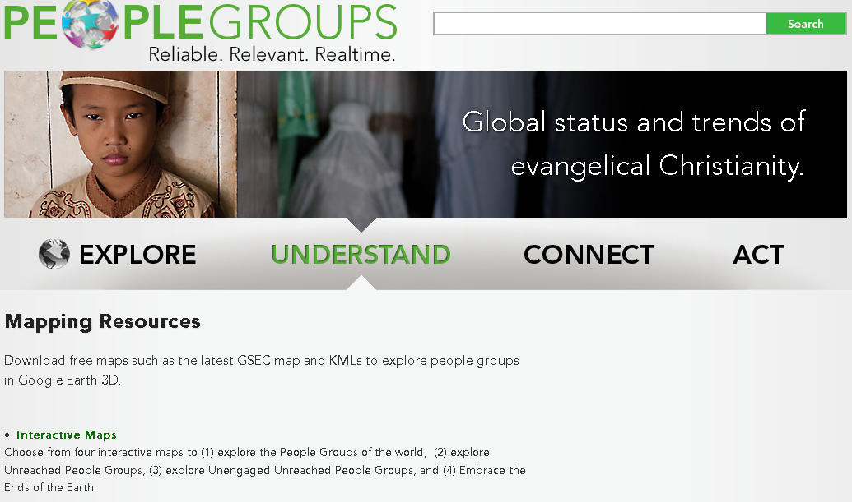
Strategic Impact Now
Notes:
Use peoplegroups.org as a place to find updated people group data.
As organizations, let’s discuss what data can be shared and how to share it.
As researchers, we need to find more venues like this to collaborate and share.
Mapping for strategic impact means bringing existing and new resources to bear on the critical questions of the day.

Slide 38
Mapping for Strategic Impact
7th International Researchers’ Conference
Kuala Lumpur, Malaysia
Steve McCord, Ph.D.
Notes:
[Set up animation]
This presentation will make the case for using maps to focus and refine strategic efforts and identify opportunities for ministry. I will use a tools which are available to you to “see” your data and research in new ways through mapping.
For many years, the mission research community has consumed information and data in various forms such as spreadsheets, lists, and text documents. Each of these tools have advantages and are extremely useful in their proper place. However, not all of the tools we have used have given us a good perspective on the data. These formats do not provide an effective method for “seeing” strategic data in a way that combines multiple sets of information into a more comprehensive perspective of what is occurring.
This session is an applied session as we will demonstrate the “how tos” to enable you to map.

